Slide 1




Public opinion of the UK’s child maintenance system
Dave Hawkey and Casey Smith
IPPR Scotland
Funded by

Slide 2


Polling summary
Main messages (part 1)
Single parents are twice as likely as parents in couples to have experienced times when they are unable to provide
their children’s basic needs
  We know single parents, the vast majority women, face structural issues that constrain their income. These polling results confirm
  that these structural issues are felt by single parents
  The public overwhelmingly agree that the child maintenance system has a role in ensuring parents can afford the essentials for children
People expect the state to actively help parents reach an effective arrangement, but the experience of separated parents who pay or receive child maintenance shows it is failing these expectations in many cases
  Over a third of parents describe their experience with the Child Maintenance Service negatively
  Over a third of parents say the current system exacerbates conflict

Slide 3

Main messages (part 2)
Parents think that charging to use the Child Maintenance Service heightens conflict and produces worse outcomes for children
  Only a minority think it is important that people who use the service should help fund it through charges
The majority of parents support alternatives to the current system which shift financial risk from children to the state
  The state pays a ‘minimum allowance’ needed to cover basic needs where the other parent cannot afford to pay this amount
  Covering child maintenance when the other parent fails to make a payment, and recovering arrears through taxation or other means

Slide 4

What we did
Aim to understand public attitudes to the UK’s child maintenance system – what is it for, what should it do, how should it work?
Asked opinion of 1,071 adults using the Diffley Partnership ScotPulse panel. Respondents were all
  Parents of children
  Living in Scotland
Responses collected between March 1 and March 5 2024
This polling relates to opinion in Scotland. However, because the findings are generally stark, we would not expect patterns of opinion to differ significantly in other parts of the UK

Slide 5
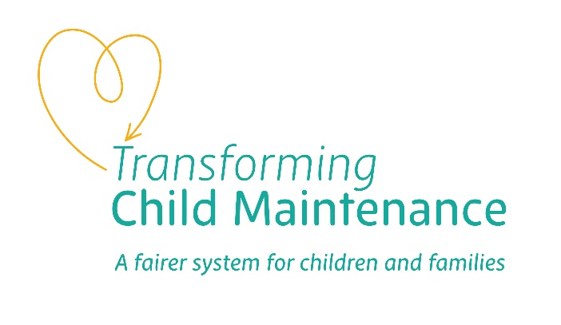
Single parents are
more likely to struggle to ensure their children’s financial security
(placeholder graphic content)
A third (34 per cent) of parents with sole care of a child said their income was too low to be “able to provide them with the most basic essentials every day”
This is roughly double the rate among parents living as couples
Sample: 726 parents in couples, 114 single parents, excludes “don’t know” response.

Slide 6
Strong support for
child maintenance to
help solve this problem
We found near unanimous agreement that ensuring parents can afford essentials for their children is an important function of child maintenance
We also found high levels of agreement that children should be financially supported by both parents
While respondents generally think it important that parents, not the government, pay for a child’s needs, support for this proposition is lower, perhaps reflecting cases where parents’ combined finances alone are too low to ensure children can afford basic needs
(placeholder graphic content)
Sample: 1,069 parents in Scotland

Slide 7
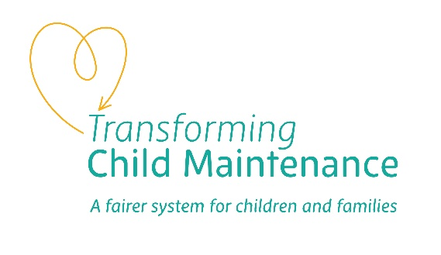
We found an expectation
that the state should actively help separated parents
Respondents think the state should have a high involvement in helping separated families arrive at a fair and working arrangement
This extends from helping parents calculate maintenance payments, to assisting in directly transferring payments
It also includes offering mediation when separating parents run into difficulties
Overall, there is a general expectation that the state should be actively supporting parents rather than taking a “hands-off” approach
(placeholder graphic content)
Sample: 1,069 parents in Scotland

Slide 8

However, in the experience
of many parents, expectations are not being fulfilled
We asked parents whether they had a positive or negative experience reflecting on the CMS’s role in helping reach an agreement
We also asked if they thought the CMS reduces or increases conflict
On both measures around a quarter of experienced parents expressed positive views. However, larger groups (over a third in both cases) said they had a negative experience and the CMS increases conflict
While there are cases in which the current approach to child maintenance works for parents, there are more cases where it does not
(placeholder graphic content)
Sample: 210 parents in Scotland with experience either
paying or receiving child maintenance

Slide 9
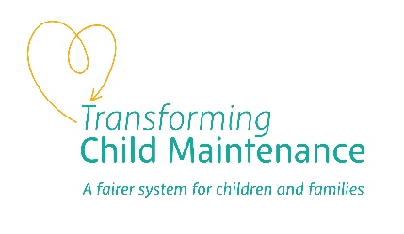
One of the ways the CMS
exacerbates conflict is by
charging parents, and most
parents agree this is a likely consequence
The majority of parents, whether they have experience with the
CMS or not, agree charging will lead to conflict and worse
outcomes for children
Almost half agree the UK government should not adopt a punitive approach to parents who cannot reach an agreement without the
help of the CMS
While around a third agree that charging will help families reach
an agreement without government support, and that charging is important to fund the service, these propositions generate the
highest level of disagreement – around a quarter reject these statements.
(placeholder graphic content)
Sample: 1,069 parents in Scotland

Slide 10
There is support for
a more radical model of CMS
Majorities think the government should have high involvement in activities that go beyond the current CMS model
Specifically, there is majority support for government to underwrite children’s financial security either when:
  The paying parent fails to pay (in which case, the state should pay and try to recover money from the paying parent)
  The paying parent does not have enough money to cover a minimum level, in which case the state should pay
(placeholder graphic content)
Sample: 1,069 parents in Scotland

Slide 11
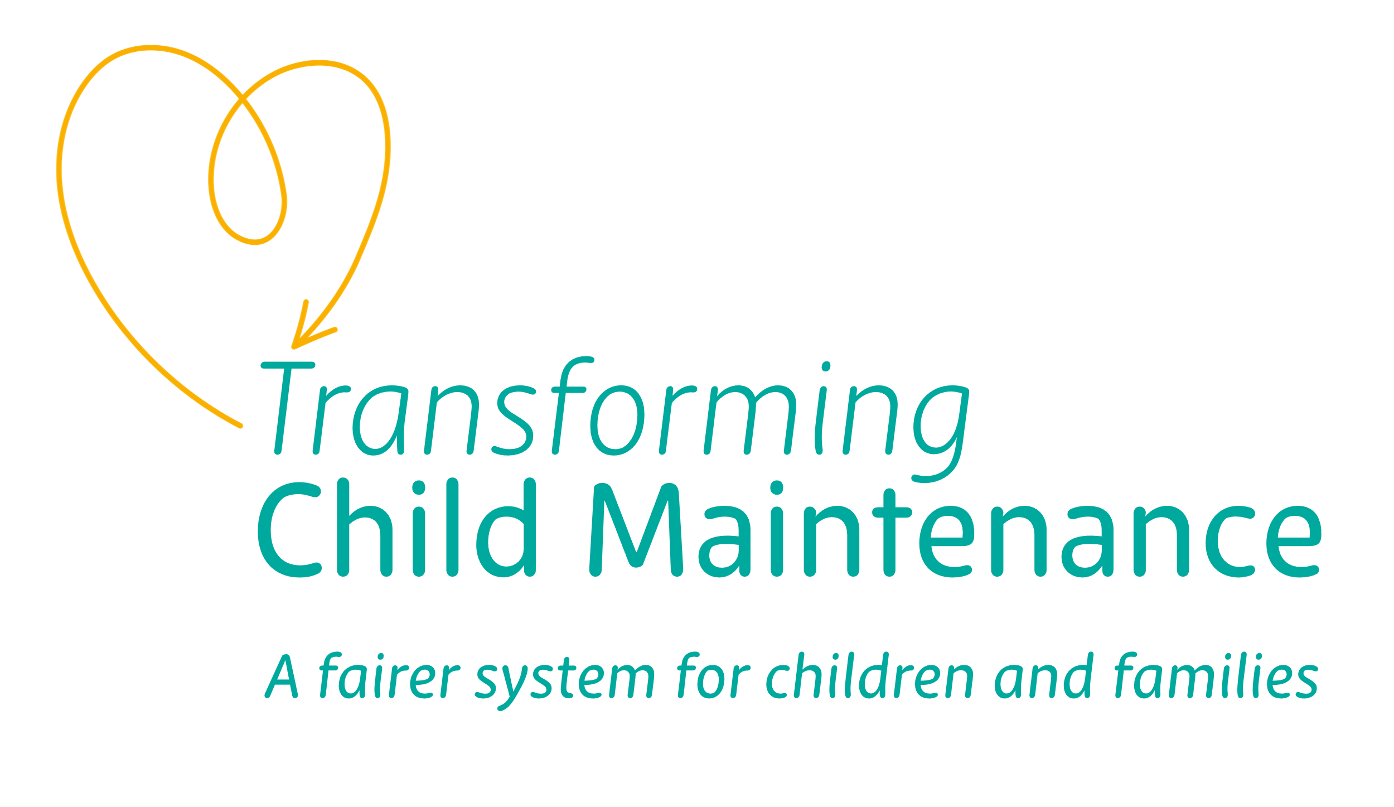
Related Transforming Child Maintenance reports
Read the interim briefing report and all other related research reports:
Child Maintenance and its impact on child poverty and financial security for single parent families, Casey Smith and David Hawkey, IPPR Scotland.
Child Maintenance and its impact on child poverty and financial security for single parent families, Casey Smith and David Hawkey, IPPR Scotland. This report presents findings from the first of the two-stage ‘Transforming Child Maintenance’ project, based on quantitative and qualitative research including focus groups, public polling, expert consultations, and statistical analysis. This stage of research involved identifying the main issues with the current child maintenance system, as set out in this briefing paper, to inform readers and stakeholders of where reform is most urgent. The briefing paper serves to inform the next stage of the research which aims to develop ambitious policy recommendations for reform of the child maintenance system.
Identifying ‘the problem’: Analysis of findings from Paying and Receiving Parent focus groups, Casey Smith, IPPR Scotland and Caitlin Logan Carter, One Parent Families Scotland.
This analysis brings together the findings from focus groups with Paying and Receiving Parents, hosted by One Parent Families Scotland and IPPR Scotland, focused on identifying the various issues parents cite while reflecting on their experience with the child maintenance system.
The role of the existing child maintenance system in children’s financial security, Dave Hawkey, IPPR Scotland.
This report is a statistical analysis which delves into the Department for Work and Pension’s Family Resource Survey and Households Below Average Income dataset to examine the relationship between child maintenance the children’s financial security, particularly the impact on child poverty in the UK.
Test and Learn: Understanding the approach to child maintenance in Fife Evaluation Report , Fiona McHardy, Poverty Alliance.
This report evaluates a local level delivery model of child maintenance, developed and delivered by Fife Gingerbread. This approach is centred around providing tailored support intended to improve the experiences of families accessing child maintenance and to support families in Fife to successfully navigate the system to ensure children receive fair financial support. Additionally, the Evaluation explored the work around capacity building within the current financial inclusion eco-system to embed Child Maintenance in these conversations with lone parents.

Slide 12




Transforming Child Maintenance partners:
Find out more about the Transforming Child Maintenance project
Get in touch
Charity no. 800065 (England & Wales), SC046557 (Scotland), Company no, 2292601 (England & Wales)
Registered at Edinburgh under number 094860. Scottish Charity Number SC006403.
Funded by
The Robertson Trust ​
Charity Registration Number: SC024254

